Slide 1
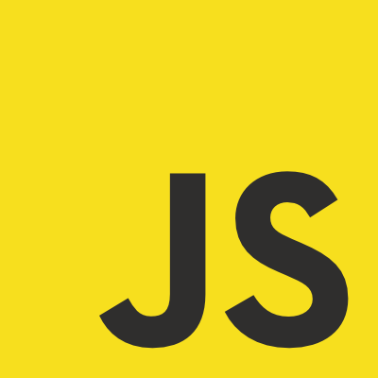
JavaScript

Slide 2
JavaScript
There are around 6 billion devices in the world that can run JavaScript.
And getting started as a developer is super simple.
Notes:
JS has everyone from phd students to ten years old copy pasters that don't even know they are programming.

Slide 3
Browser
Two main components:
A JavaScript engine:
Such as V8 in Chrome
http://en.wikipedia.org/wiki/JavaScript_engine
A browser rendering engine:
http://en.wikipedia.org/wiki/Web_browser_engine
The link between the two is the DOM.

Slide 4


Slide 5
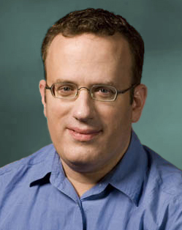
Brendan Eich

Slide 6
JavaScript
Mocha
LiveScript
ECMAScript

Slide 7
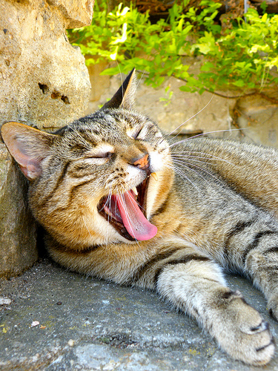
JavaScript is
one of the only
languages
developers don't
feel they need to learn.
http://www.flickr.com/photos/barockschloss/3791527519/sizes/m/in/photostream/

Slide 8
JavaScript
"Hidden under a huge steaming pile of good intentions and blunders is an elegant, expressive programming language.
JavaScript has good parts"
Douglas Crawford

Slide 9
JavaScript Influences
Self: Prototypal inheritance,
Dynamic objects
Java: Syntax,
Conventions
Scheme: Lambda,
Loose typing
Perl: Regular Expressions

Slide 10

http://www.flickr.com/photos/tomitapio/5601194718/sizes/z/in/photostream/
Notes:
Open your eyes and minds and learn JS.
It looks similar to C# and Java but it works differently

Slide 11
JavaScript
Let me introduce my dear friend:
Chrome console:
Notes:
Right click inspect elements, console.

Slide 12
JavaScript
Values:
      number
      string
      boolean
      object
      function
      undefined

Slide 13
JavaScript
Declaring a variable:
var a = 1; //GOOD
vs
b = 1; // BAD

Slide 14

JavaScript is loosely typed
http://farm3.staticflickr.com/2689/4143179870_b75122f3c0_b.jpg
Notes:
We only have one typeof number this is seriously cool.

Slide 15
Number
1 + 1;
2 * 2;
6 / 3;
var a = 4;
typeof a;
Notes:
We only have one typeof number this is seriously cool.

Slide 16
Only one type of number
http://farm3.staticflickr.com/2689/4143179870_b75122f3c0_b.jpg
Notes:
We only have one typeof number this is seriously cool.

Slide 17
Number
var b = 0.3;
var a = 0.1 + 0.2;
(b == a);

Slide 18

They choose the wrong one
http://www.flickr.com/photos/fvbg/5457033663/sizes/m/in/photostream/
Notes:
We only have one typeof number this is seriously cool.

Slide 19
Number gotchas
var a = prompt("enter a number");
var b = a + 1;
var a = Number("1");
Number("a");

Slide 20
JavaScript has type
coercion it's a bitch at times.
The + operator concatenates strings and adds numbers
http://www.flickr.com/photos/fvbg/5457033663/sizes/m/in/photostream/
Notes:
We only have one typeof number this is seriously cool.

Slide 21
JavaScript
var a = prompt("enter a number");
// Type Hello instead of a number
var b = Number(a);
// checkout b
typeof b;

Slide 22
Strings
var greeting = "Hello";
typeof greeting;
var thanks = 'Tack';
var greeting2 = new String("Hej"); // BAD
typeof greeting2;
var strNum = String(12);
typeof strNum;
var crazy = 1 + "a" + "b" + true + {};
typeof crazy;

Slide 23
String common methods
"12,14,15,16".split(",");
"Hello".toUpperCase();
"Strings are fun"[3];
"Replace me".replace("me");
"Replace me".substr(3,4);
"Replace me".substring(3,7);
There are quite a few more methods https://developer.mozilla.org/en/JavaScript/Reference/Global_Objects/String#Methods

Slide 24
boolean
var a = true;
var b = false;
var badBool = new Boolean("true");
typeof badBool;
var betterBool = Boolean("true");
typeof betterBool;

Slide 25
boolean operators
(0 == false);
(0 == "0");
(0 != "0");
("0" == false);
("false" == false);
(false == undefined);
(undefined == null);
(null == "false");
(5 < 7 && 6 >= 8 || (4 == 3));

Slide 26
type coercion can
really be a bitch...
http://www.flickr.com/photos/fvbg/5457033663/sizes/m/in/photostream/
Notes:
We only have one typeof number this is seriously cool.

Slide 27
=== is what you want,
(0 === false);
(0 !== "0");
(0 === "0");
("0" === false);
("false" === false);
("false" === undefined);
(undefined === null);
(null === "false");
var newBool = new Boolean("true");
(newBool === true);
(newBool == true);
var newBool2 = Boolean("true");
(newBool2 === true);
(newBool2 == true);

Slide 28
Sanity restored
http://farm3.staticflickr.com/2689/4143179870_b75122f3c0_b.jpg
Notes:
We only have one typeof number this is seriously cool.

Slide 29
Objects
JavaScript kicks arse when it comes to objects.
var anObject = {};
anObject.someProperty = "I'm a value";
var aSecondObject = {
property:"hello",
anotherProperty:"goodbye"
};
var anotherObject = new Object();

Slide 30
Objects are dynamic
var myObject = {};
var theUserDefinedProperty = prompt("Enter a property name");
var thePropertyValue = prompt("Enter a value for your property");
myObject[theUserDefinedProperty] = thePropertyValue;
There area a couple of other ways in which you can construct objects in JS we will return to them later.

Slide 31
Object literals rock
http://farm3.staticflickr.com/2689/4143179870_b75122f3c0_b.jpg
Notes:
We only have one typeof number this is seriously cool.

Slide 32
Functions
var aFunc = function() {
console.log("hello from a");
}; // <-- note the semicolon
function bFunc() {
console.log("hello from b");
}

Slide 33
Function return
Functions always return a value.
If you don't specify a value they return undefined.
var aFunc = function(){
// Some clever code
};
var greet = function(){
return "Hello";
};

Slide 34
Function arguments
var add = function(a,b){
return a + b;
};
add(1,3);
add(1,3,5,7,"crazy");

Slide 35
Function arguments continued
var func = function() {
console.log(arguments);
};
func(1,2,"hello",true);
var adder = function() {
var result = 0;
for(var i = 0; i < arguments.length; i++){
result += arguments[i];
}
return result;
};
adder(1,3,7);

Slide 36
Functions
Functions are values in JavaScript.
Functions are values in JavaScript.
Functions are values in JavaScript.
Functions are values in JavaScript.

Slide 37
Function scope
var greeting = "Hello";
var greeter = function() {
var greeting = "Hej";
};
greeter();
greeting;

Slide 38
JavaScript
var greeting = "Hello";
var greeter = function() {
greeting = "Hej";
};
greeter();
greeting;

Slide 39
Functions as values
var queue = [
function() { alert("func 1");},
function() { alert("func 2");},
function() { alert("func 3");}
];
for(var i = 0; i < queue.length; i++){
queue[i]();
}

Slide 40
Functions as values continued
var aFunc = function() {
alert("a function");
};
var bFunc = function(func){
alert("b function");
func();
};
var cFunc = function(){
return function(){
alert("internal returned function");
};
};

Slide 41
functions are values
http://farm3.staticflickr.com/2689/4143179870_b75122f3c0_b.jpg
Notes:
We only have one typeof number this is seriously cool.

Slide 42
Undefined
var obj = {};
obj.a;
typeof obj.a;
obj.a === undefined;

Slide 43
JavaScript
var myArray = [1,2];
myArray.push("hello");
myArray.length;
var bArray = new Array(); // don't use this
Methods that can be used on arrays:
https://developer.mozilla.org/en/JavaScript/Reference/Global_Objects/Array#Methods
Notes:
Arrays are phoney arrays in Javascript they are actually objects.
+ They don't need to be dimensioned.
- They are a slower to iterate over.

Slide 44
JavaScript
var myArray = [1,2,"hello"];
for(var i = 0; i < myArray.length; i++){
alert(myArray[i]);
}
// don't use
for(var key in myArray){
}
//the above for in loop is for iterating over keys in an object and not arrays
Notes:
To illustrate for in and preventing a deep drudge of the prototype chain.for (var prop in obj) {
if (obj.hasOwnProperty(prop)) {
// prop is not inherited
}
}

Slide 45
JavaScript
var n = 0;
while(n < 4){
console.log(n);
n++;
}
Notes:
If needed do while will always run at least one iteration.do { i += 1; document.write(i); } while (i < 5);

